Slide 1

Group OBE Presentation
Name | Id
Ahamed Fardit | 18-36119-1
Md. Asif Haiat | 17-34664-2
Mehidi Hasan | 18-38455-2
Saiful Islam Shuvo | 16-32620-3
SHAZIDUL ISLAM | 17-34207-1 (Absent)

Slide 2
Ahamed Fardit
18-36119-1
5 volt Charger

Slide 3

Apparatus
PCB Design
With Multisim
What is PCB design?
VCC
RESISTOR
DIODE
CAPACITOR
SYMMETRY DESIGN SYSTEMS (LM7805CT)
LED GREEN
TERMINAL BLOCKS (282834-2)
GROUND
Connecting wires.
Printed circuit board (PCB) design brings our electronic circuits to life in the physical form. Using layout software, the PCB design process combines component placement and routing to define electrical connectivity on a manufactured circuit board.

Slide 4

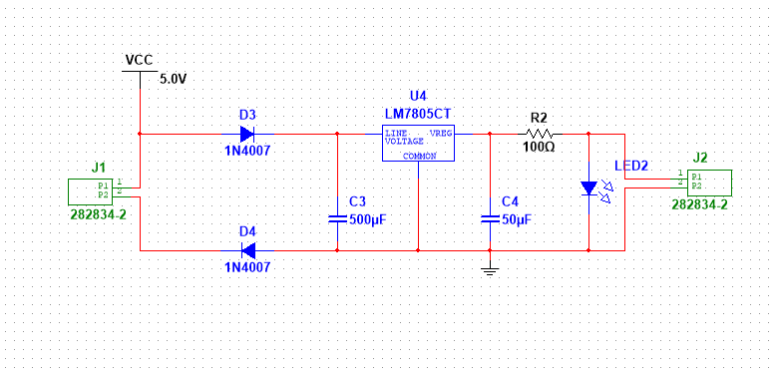
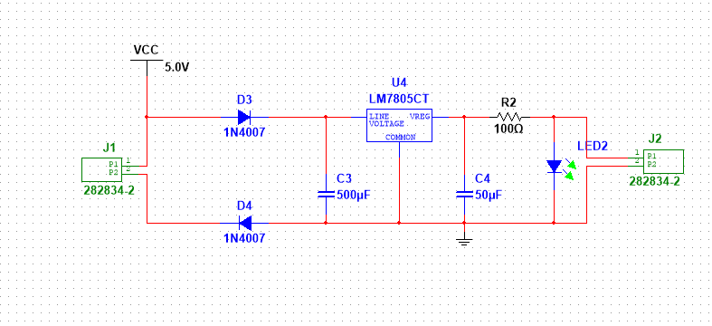
Schematic For 5V Charger Circuit

Slide 5


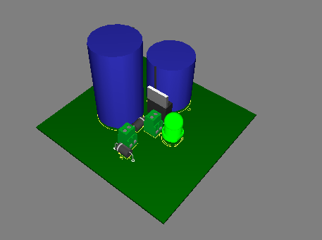
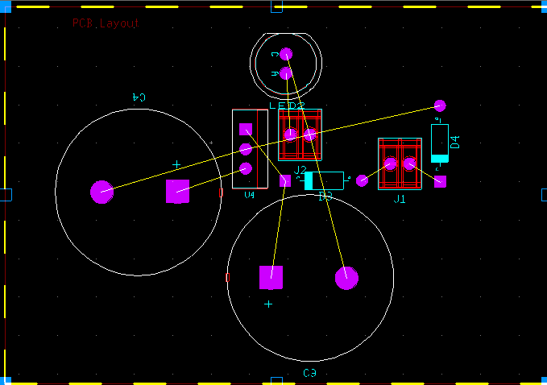
3D View
PCB Layout

Slide 6
Haiat, Md. Asif 17-34664-2 AC Voltage Detector

Slide 7
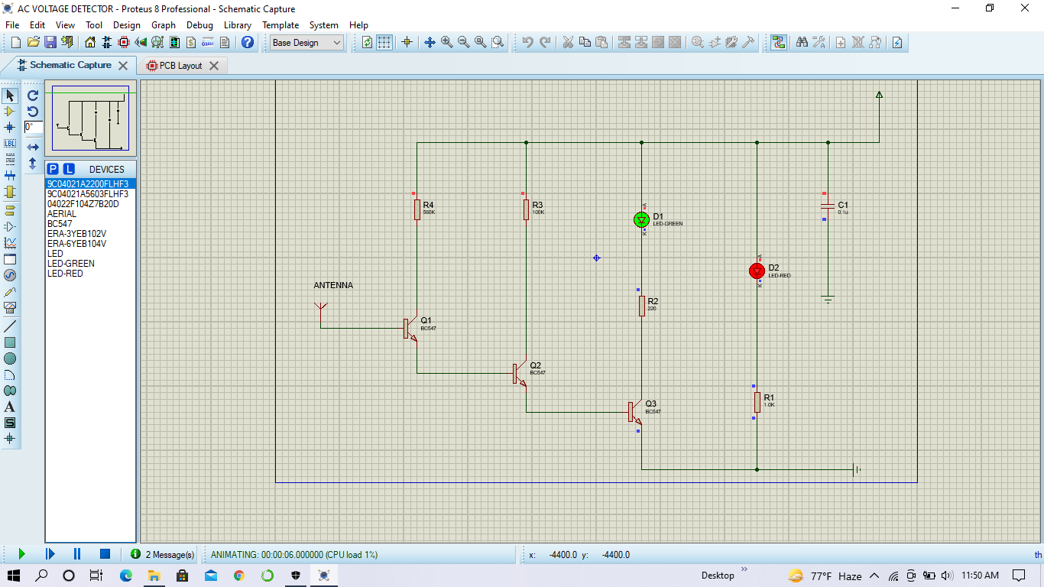
AC Voltage Detector : Schematic Capture
Component in Use:
3 NPN transistor- BC547
4 resistor
1 capacitor
2 LED
Copper wire
9V battery
Proteus Software

Slide 8
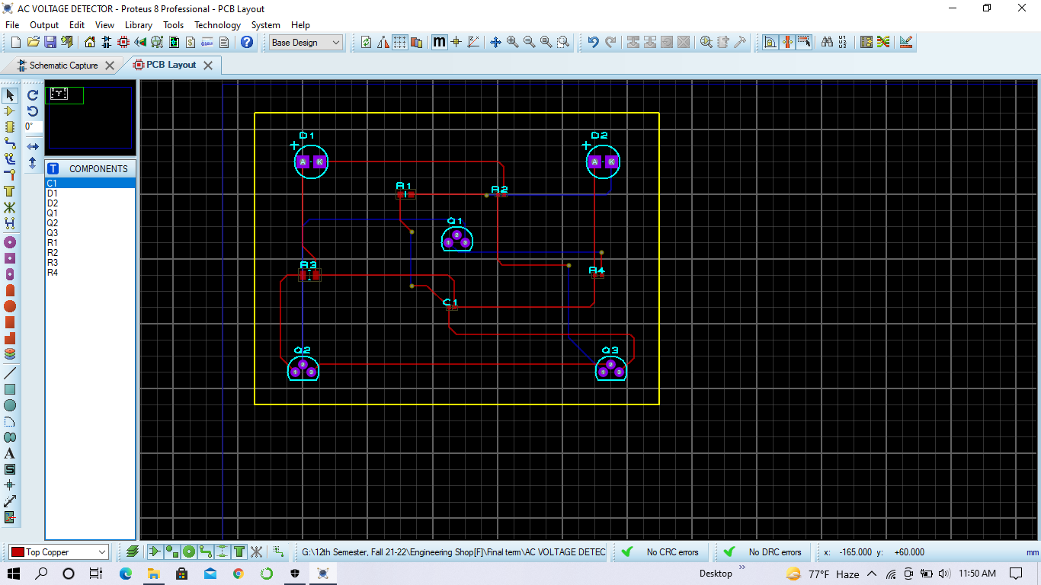
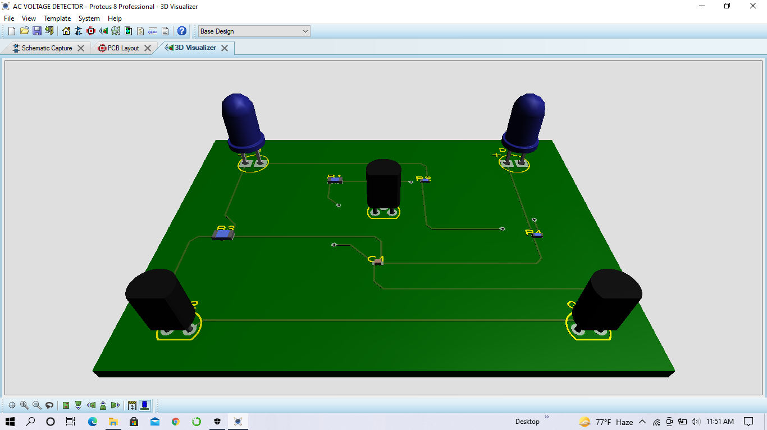
PCB layout & 3d visualizer
PCB layout implementation of AC voltage detector
3D visualizer: AC voltage detector

Slide 9
Mehidi Hasan 18-38455-2 Music Reactive LED Circuit PCB Board

Slide 10
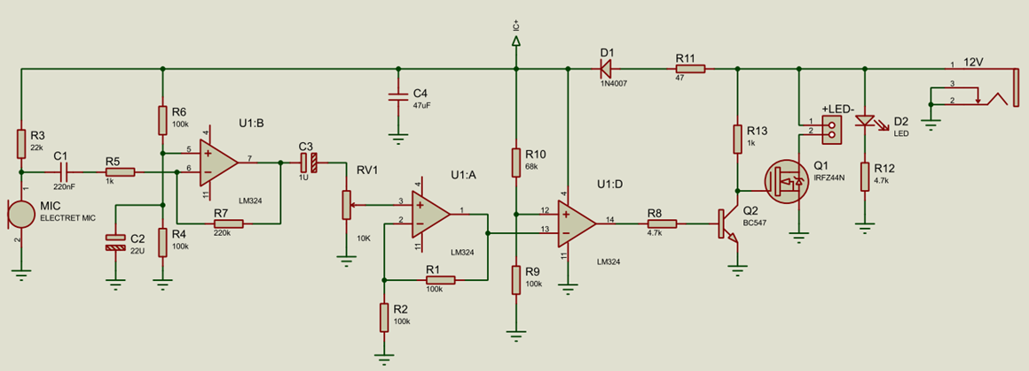
Schematic Capture

Slide 11
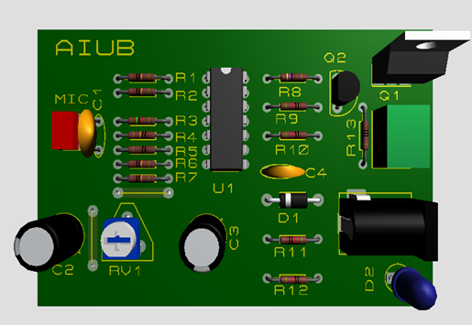
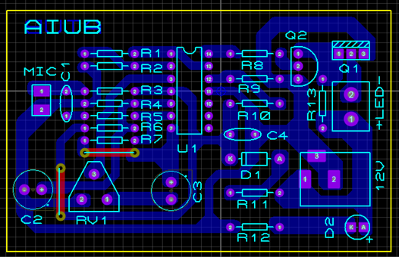
3D View
PCB Layout

Slide 12
Shuvo Saiful Islam 16-32620-3 Full wave rectifier circuit​ ​

Slide 13
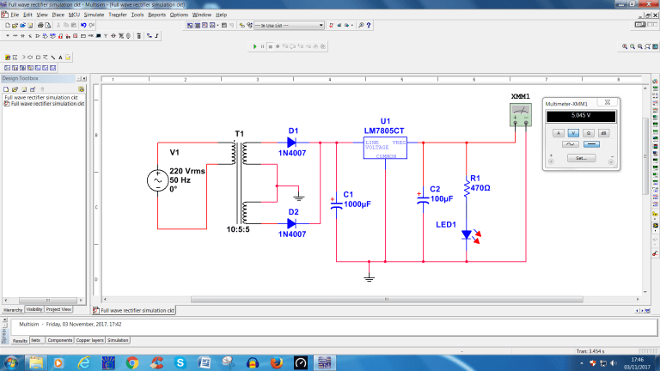
Schematic Capture
Component in Use:
Configurable transformer
2 Diode
2 Cap electrolyte
Voltage regulator
Resistor
LED red
Ac power
Ground
Multimeter
Multisim

Slide 14
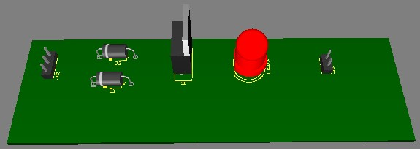
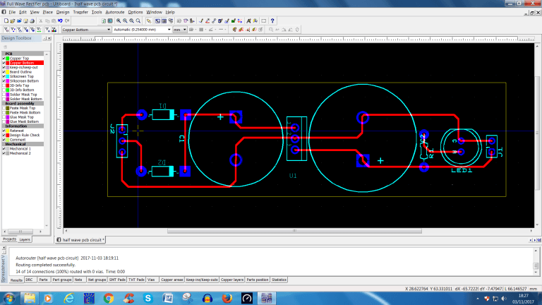
PCB LAYOUT
3D View

Slide 15
Thank you

